Slide 1
World’s Smartest Unified Business Communication & Collaboration App
Enterprise Deck

Slide 2
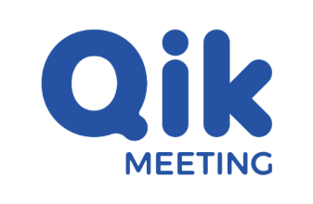
Solving 30 different communication and collaboration problems in 2023
Problem #1: Using Personal Communication Tools
Eg: 80% of employees still use personal chat tools like WhatsApp for basic communication.
Problem #4: Sub-standard account usage of communication software
Eg: Most of the company uses video conferencing tools like Zoom but manage with 3 paid accounts for all employees
Problem #2: In-person meeting apps don’t exist
Eg: Employees do 150% more in-person meetings than online meetings but have no access to this data
Problem #5: Data not organized inside and outside organization
Eg: Employees still use traditional notepads to store their notes & other communication data
Problem #3: Minutes of Meetings don’t exist
Eg: Most of the company has less than 10% of the meetings recorded and less than 1% have MoMs communicated manually.
Qik Meeting
A smarter unified business communication & collaboration app which can truly organize & automate work data increasing productivity by over 300%.

Slide 3
Innovations
Space Agnostic
World’s first in-person meeting app
World’s fastest online meeting app
World’s most powerful one-on-one rooms
Audio/video call meetings
AR/VR meetings, smart devices & mobility meetings, holographic meetings* (futuristic)
Communication Data
World’s most advanced AI powered Meeting Rooms
World’s most organized & integrated chat
Enterprise data cocooning, security & privacy
Unified Collaborative Experience
World’s most advanced business scheduler
World’s first integrated AI powered minutes of the meeting app
Unifies meetings, chat, notes, to-dos, files, recordings etc.,
ML powered 99% accurate transcriptions

Slide 4
Innovation:
World’s most advanced AI-powered Meeting Room

Slide 5
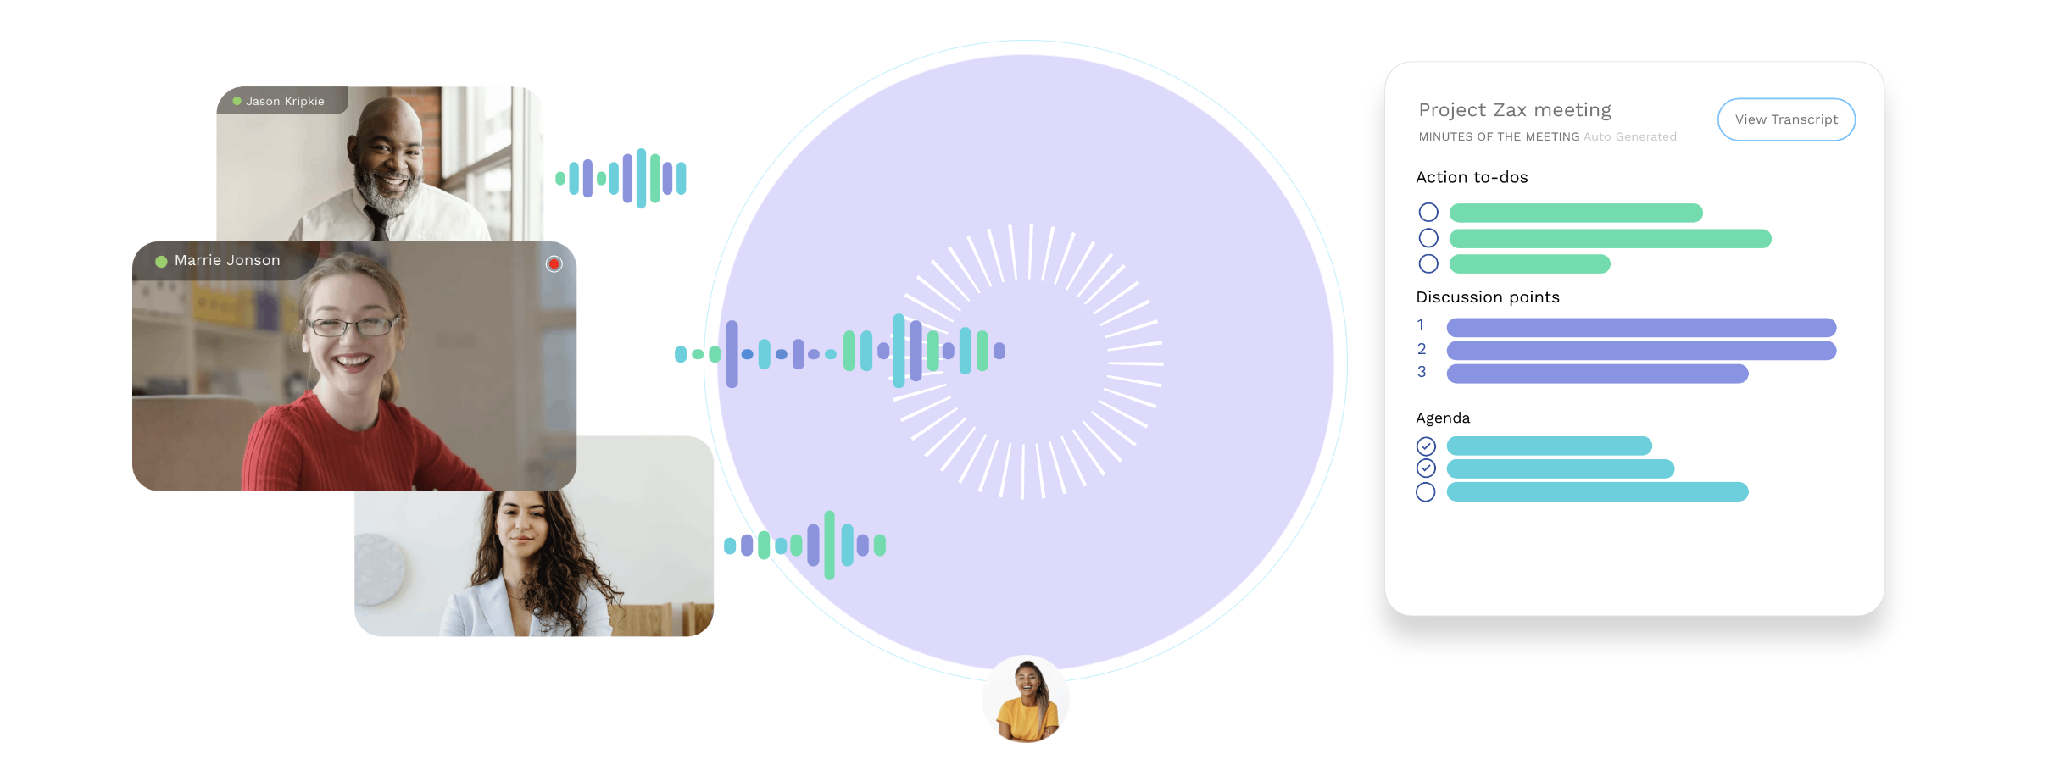
World’s first integrated minutes of the meeting
World’s first AI-powered Meeting Rooms

Slide 6
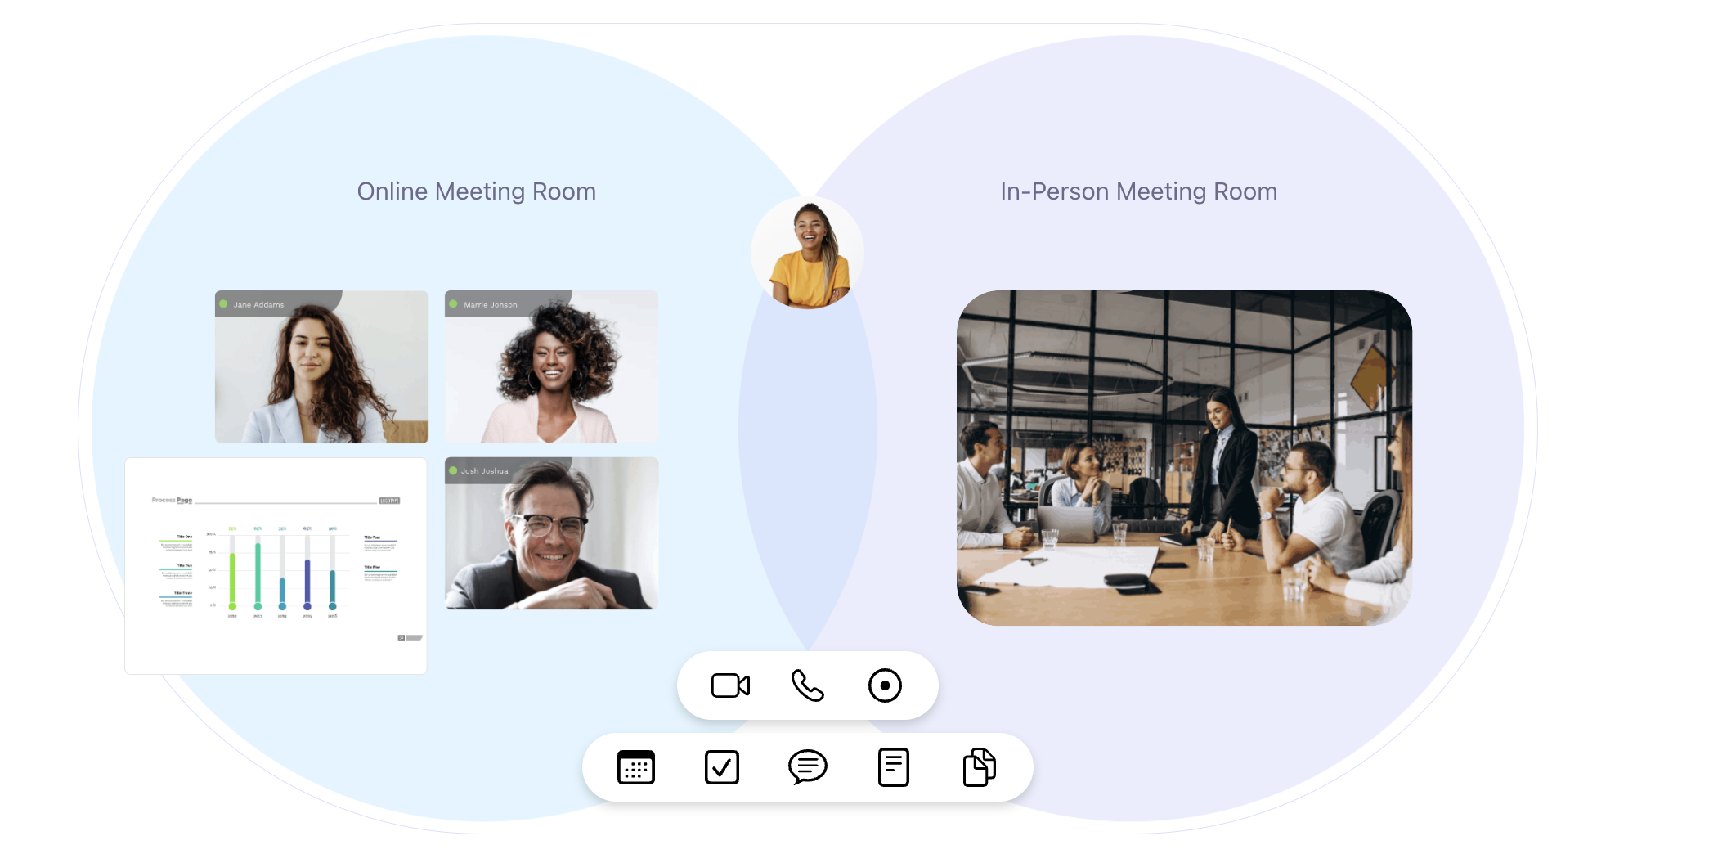
World’s fastest online meeting app
World’s first in-person meeting app

Slide 7
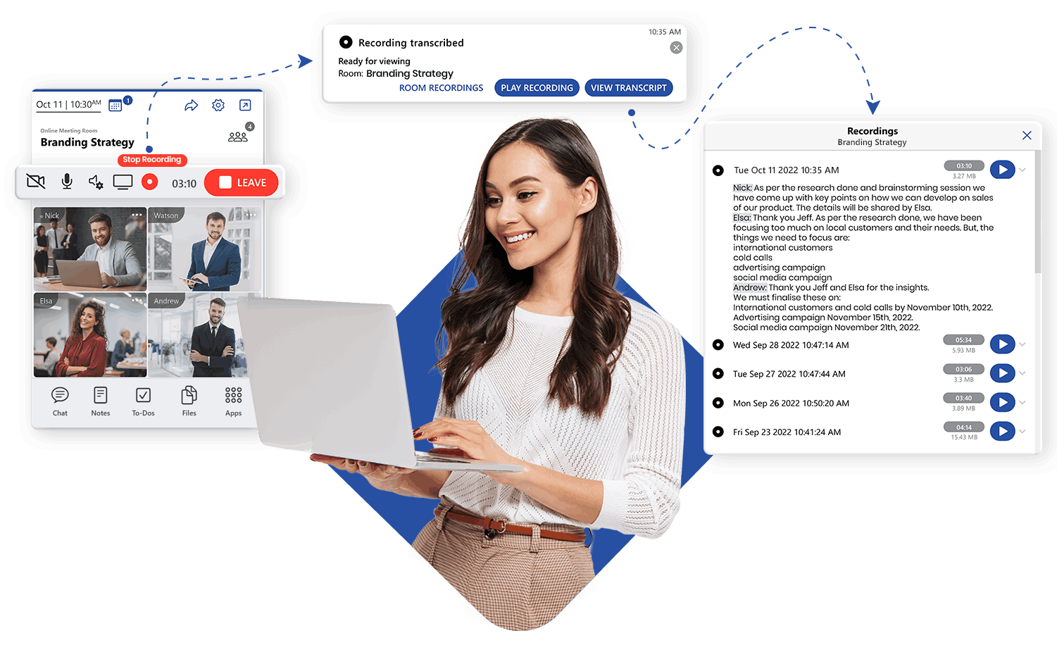
99%* Accurate Transcriptions in 10+ Languages

Slide 8
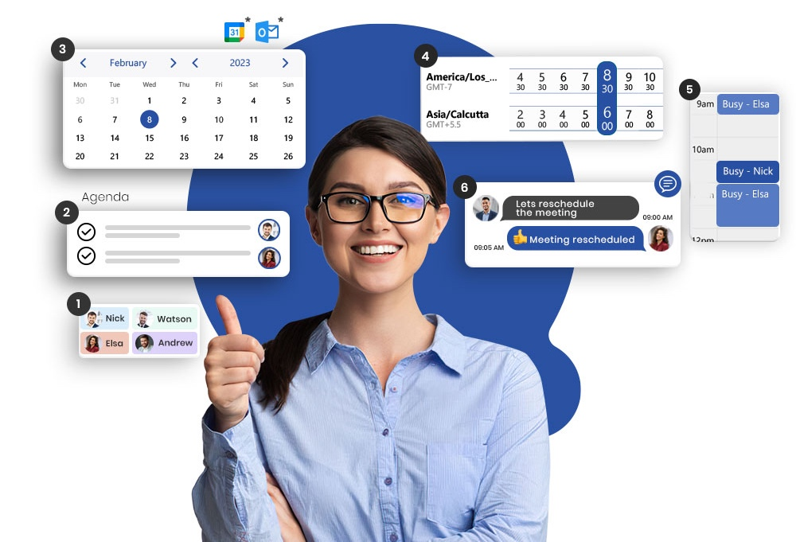
World’s most advanced scheduler app

Slide 9
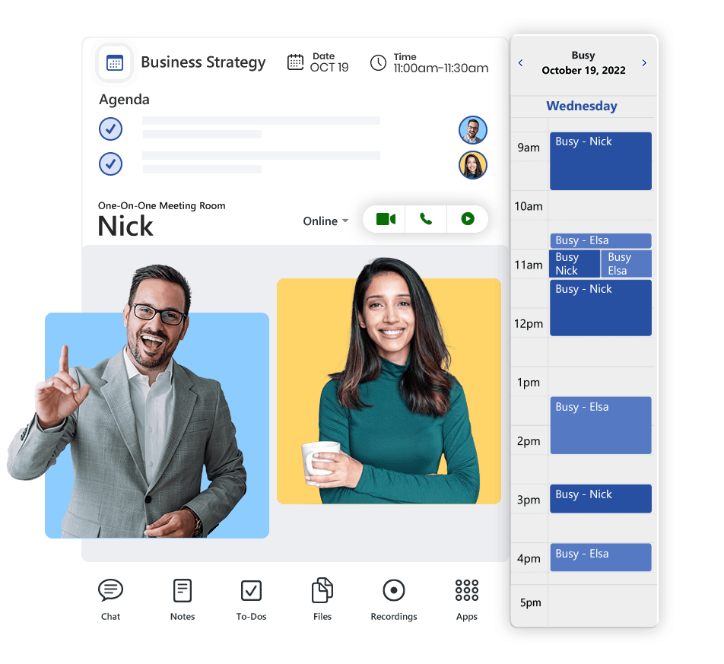
World’s most powerful One-on-one Meetings

Slide 10
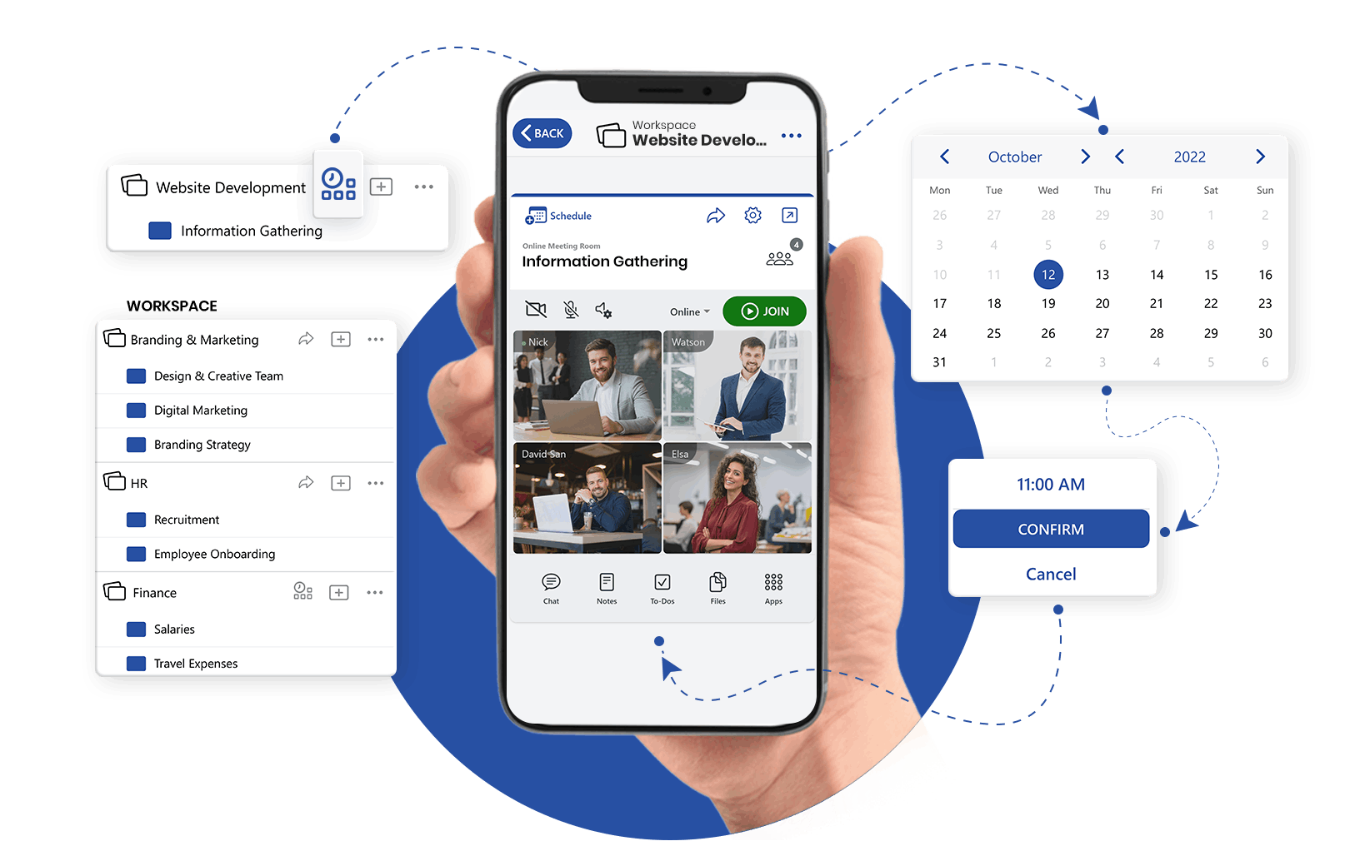
Share Appointment Calendars

Slide 11
World’s best unified work organizer

Slide 12
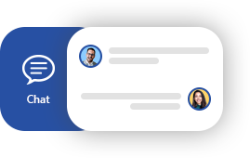
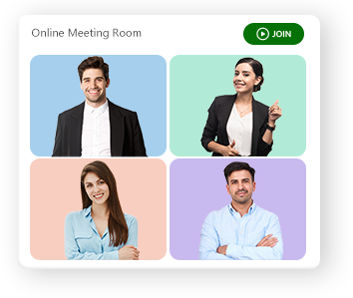
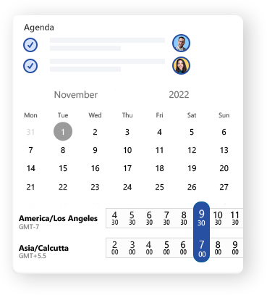
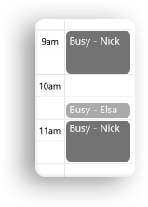
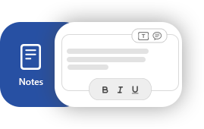
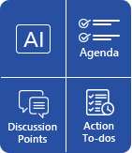
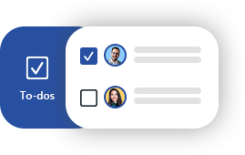
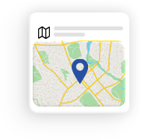
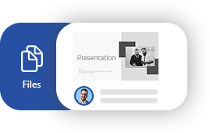
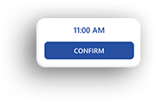
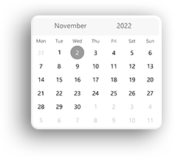
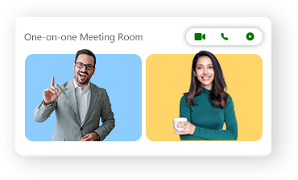
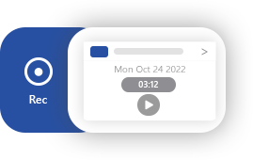
World's most advanced scheduler
World’s fastest online meeting app
Smartest Unified Communication App
Fully Automated
MoMs
World’s first in-person meeting app
Integrated meeting appointments
99%
Accurate
Transcriptions
World’s most powerful one-on-ones

Slide 13
1. Single Pane of Glass Dashboard
Key
Features
One Dashboard for all your work
Auto Persistent Communication Data
One click join and access to all Data
2. Space Agnostic Meetings
4. Never Seen Communication Data
First ever In-person meeting app
Fastest online meeting app ever
Best hybrid meeting app
App to app call meetings
One-on-one meetings
Best Persistent Meeting Organizer ever
AR/VR/Device/ Holographic Meetings*
AI powered integrated minutes of the meeting
ML based Auto Transcriptions (99% accuracy)
AI powered Auto-instant MoMs
Enterprise Chat that replaces WhatsApp & Teams/Slack
Enterprise Real-time Collaborative Notes
Enterprise To-do Lists
File sharing & room recordings
3. Best Scheduler Ever
Schedule with busy time awareness
One-click scheduling
Agendas for better productivity
Multi-Timezone mapping view
Smart Calendar integrations
Calendly style appointment scheduling
5. Unified Business Communication
Data syncing in real time
Contextual & Universal In-app Search
Best suited to be used for inside and outside the organization
Download on Mac, Windows, iPhone, Android or access https://qik.mt via browser
*Scheduled in future releases

Slide 14
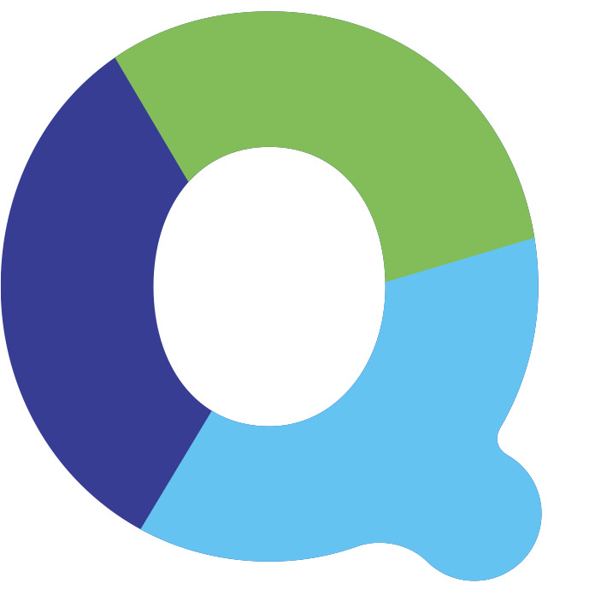
USPs
Highly Productive & Cost-Effective
More than 300% productivity increase
Save more than $100 per employee per month
Replaces a bunch of communication tools within the organization
Hybrid, Unified & Accessible Anywhere
Single dashboard view to organize all your work in one place
One click switch to any meeting room & access anywhere, any time, any device.
Patent Pending Technologies (USPTO: 555,384 INDIA IP: 202141056307)
Enhanced Security, Server Efficiency & Scalability
Data cocooning, e2e encryption, advanced enterprise security & proprietary technology
50% higher server efficiency per meeting for the same quality which reduces cloud costs
Highly scalable architecture

Slide 15
Benefits
Guarantees huge productivity gains of more than 300%.
Build great teams in your organization.
80% of projects are lost due to poor communication. No longer in your business.
Do smarter and faster business with effective meetings.
Grow your business without additional effort.
200% more work data at your fingertips fully organized.
Truly built for working as a team

Slide 16
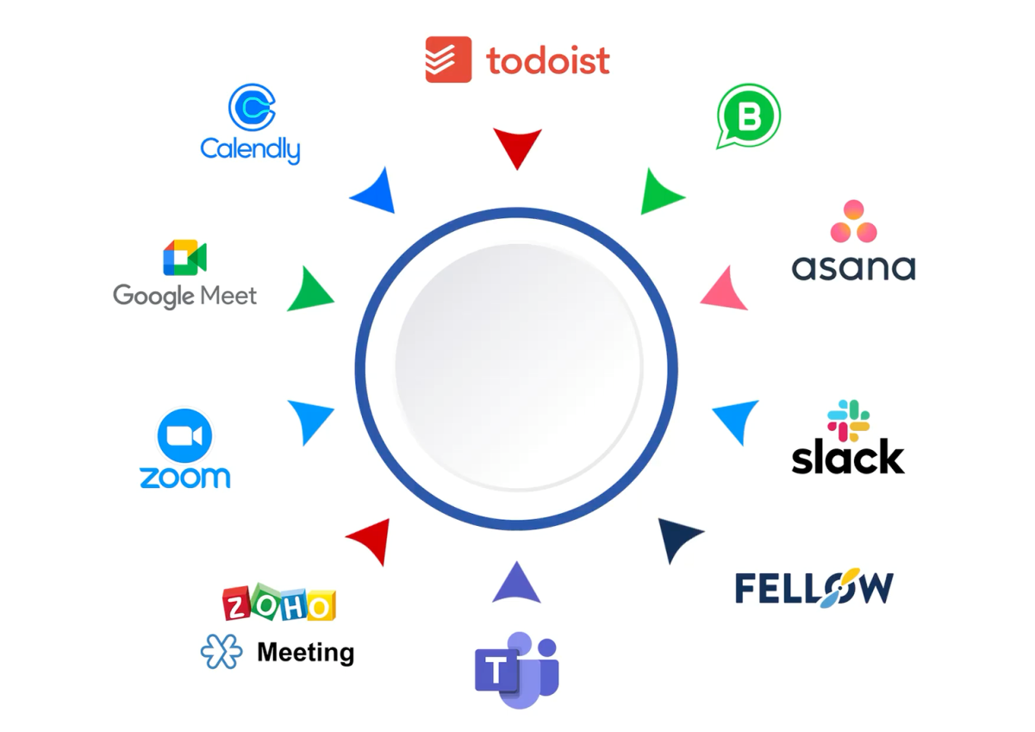
Save more than
$100* per employee
190+ companies who love their
smarter meetings now
One app for all Business Communication

Slide 17
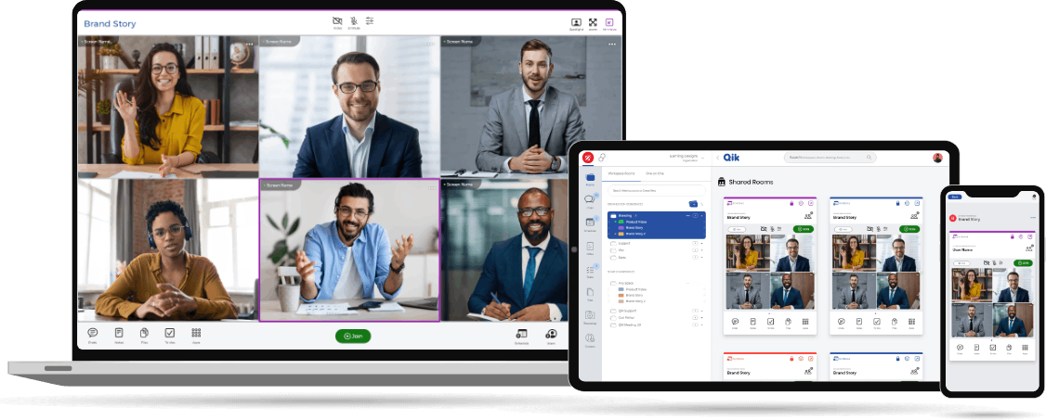
Access anywhere,
any device, any time
Contact Us at HiHo Solutions Ltd
0161 767 2540
Neil.hinde@nbdata.co.uk
HiHoSolutions.co.uk

